Slide 1
NEPAL

Slide 2
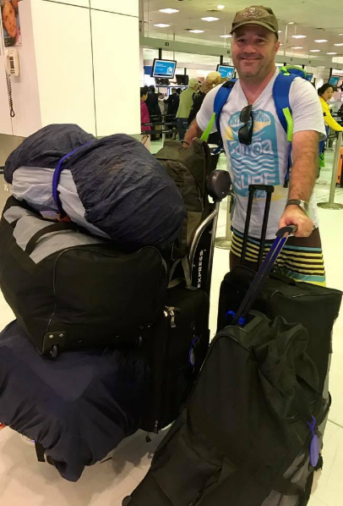
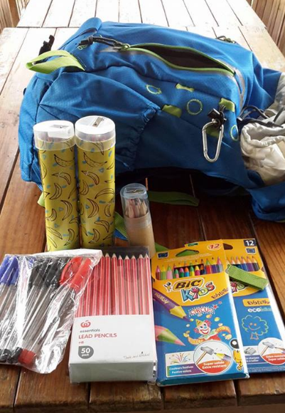

Slide 3
LOOM Nepal

Slide 4
Nayapul to Tikedhunga

Slide 6
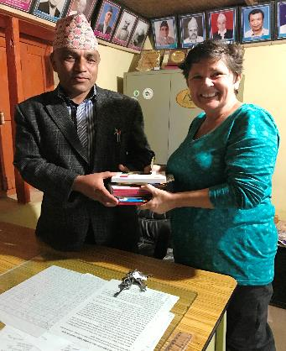
Ghandruk

Slide 7
Birethanti

Slide 8
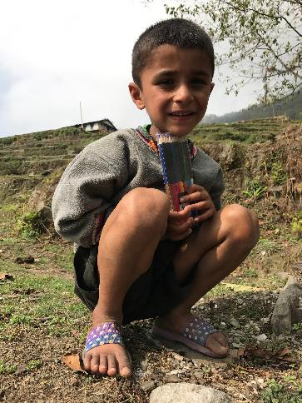
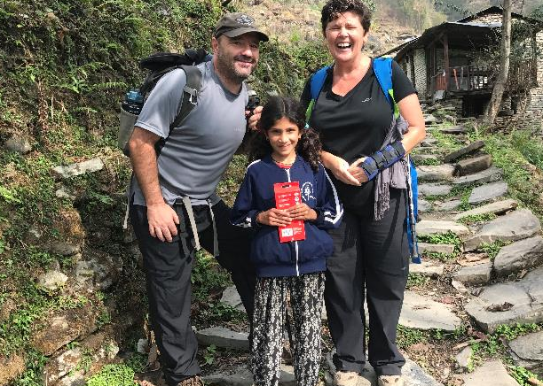
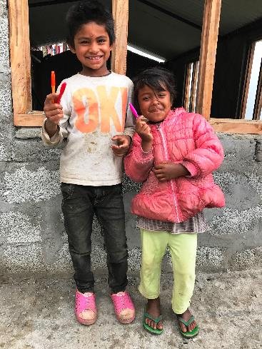

Slide 9
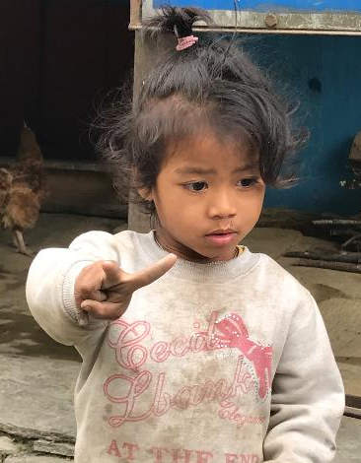
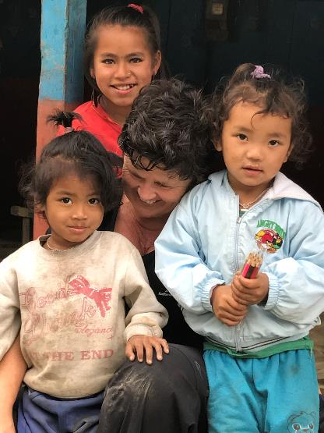
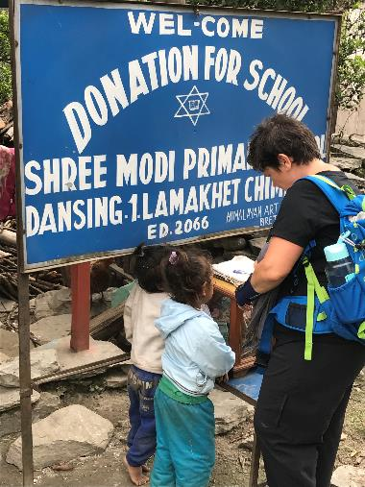

Slide 10
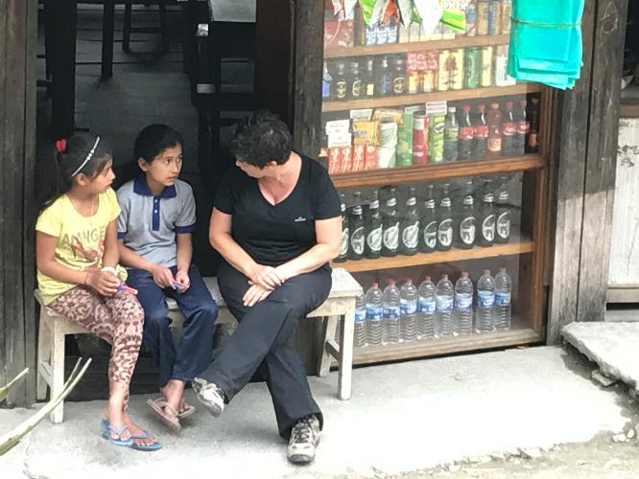
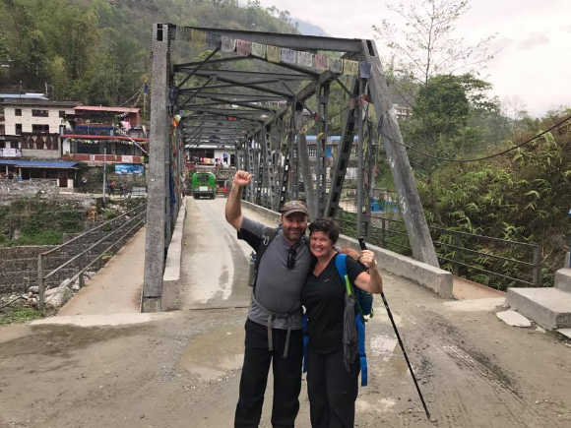

Slide 11
Pokhara

Slide 12
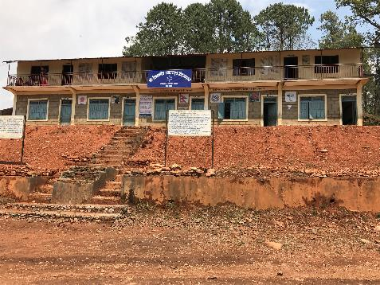
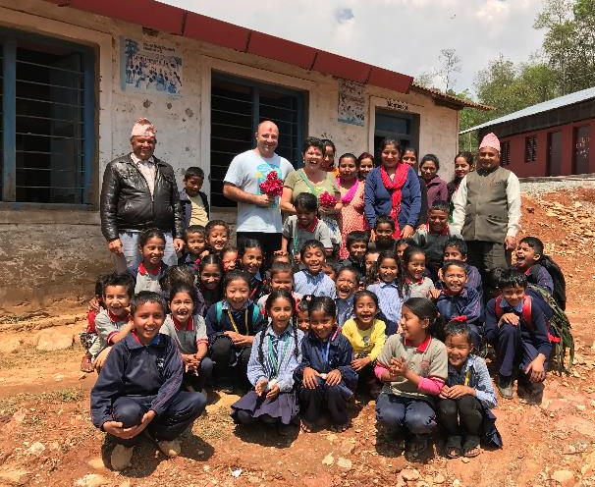
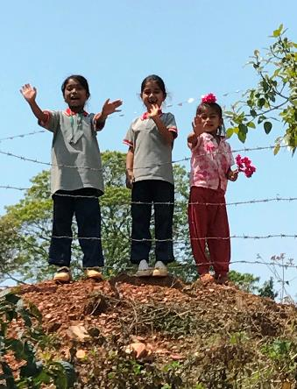

Slide 13
After getting his Master’s Degree in education from University of Nebraska, Mahabir Pun returned to his native village Nangi in Nepal, with a courageous and ambitious goal to set up a school that will serve as a model for local educational as well as economic development.

Slide 14
Kevin Rohan Memorial Foundation

Slide 15
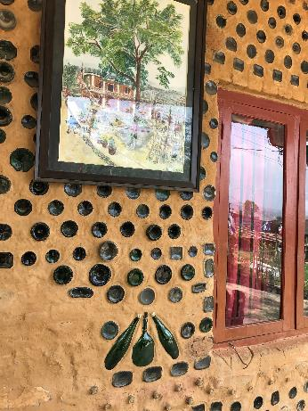
KRMF

Slide 16
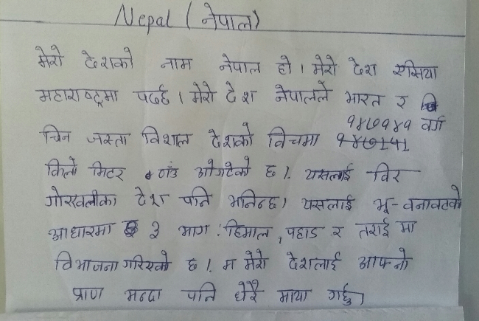

Slide 17
Thankyou
Lake Munmorah Public School

